Slide 1
Wireframe Demo: Transportation Fuels Reporting System
British Columbia Renewable and Low Carbon Fuel Requirements Regulation (RLCFRR)

Slide 2
Outline
Introduction – What we’re doing
Wireframes
Fuel Supplier Dashboard
Credit Transfer Operations
Account Activity
Notifications
Posting Opportunities
Organizational Information
Discussion and next steps

Slide 3
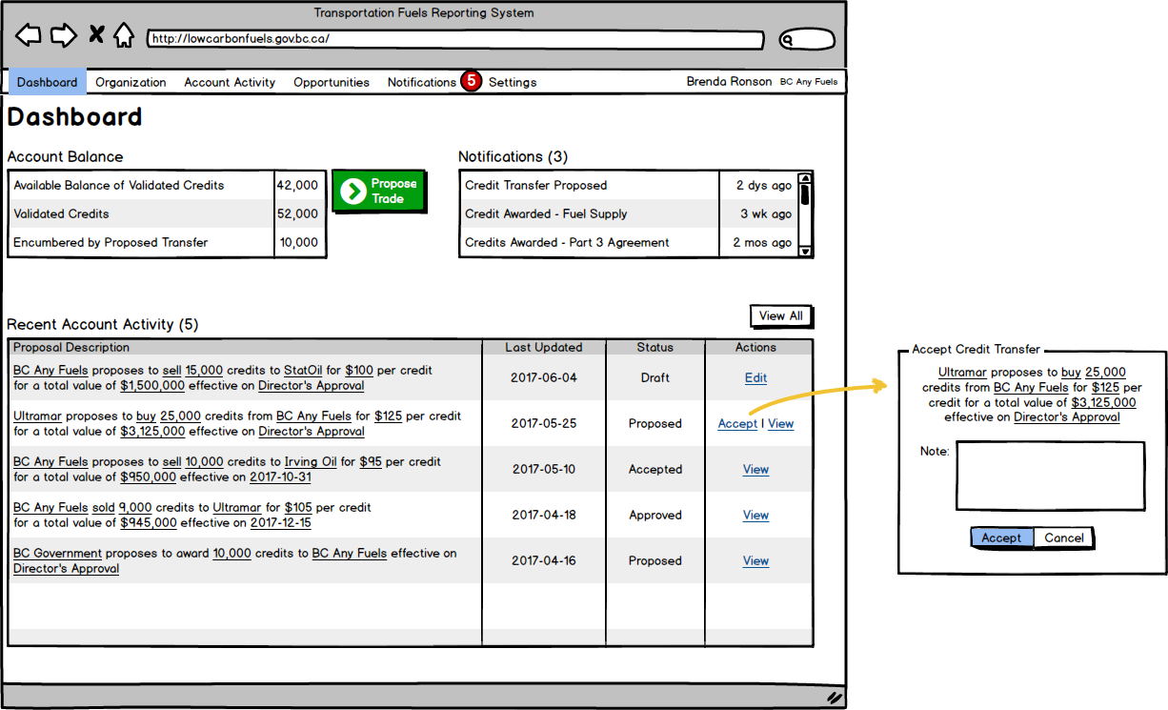
Fuel Supplier Dashboard

Slide 4
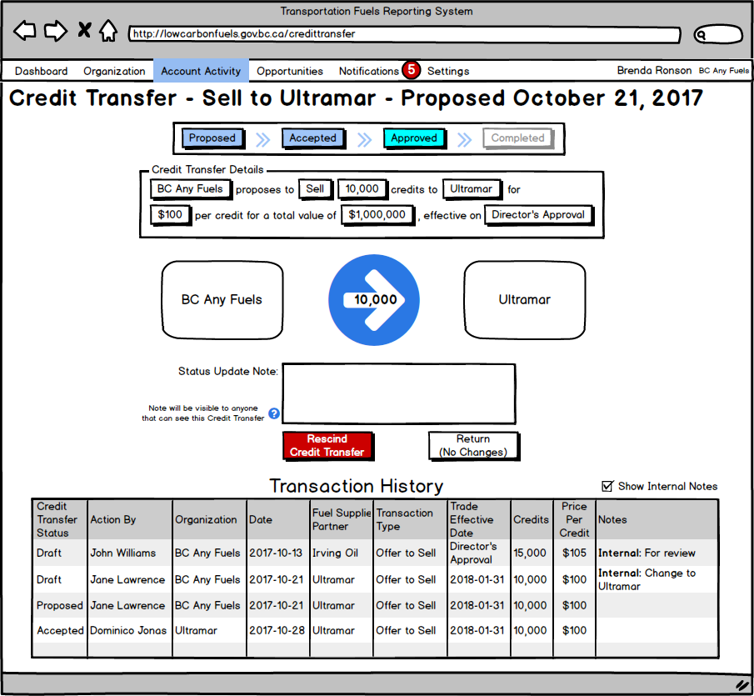
Credit Transfer Operations

Slide 5
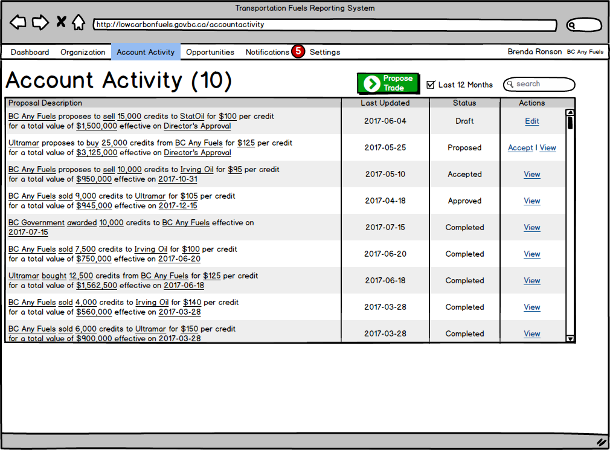
Account Activity

Slide 6
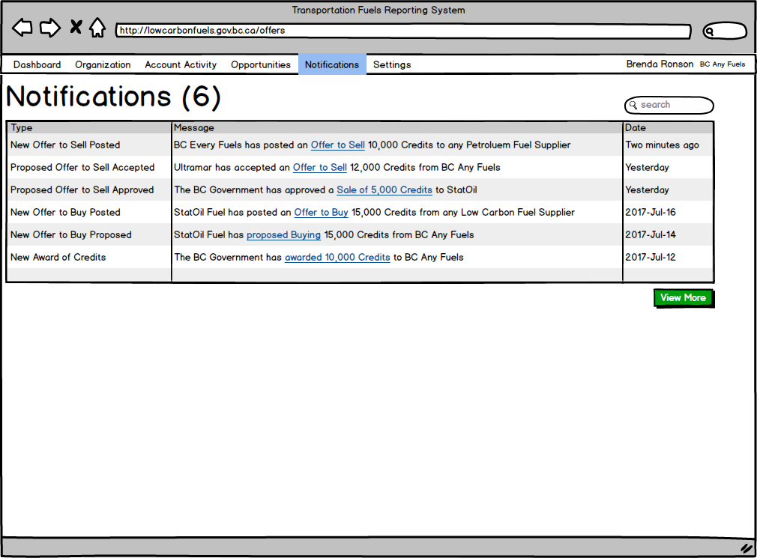
Notifications – via Email and SMS

Slide 7
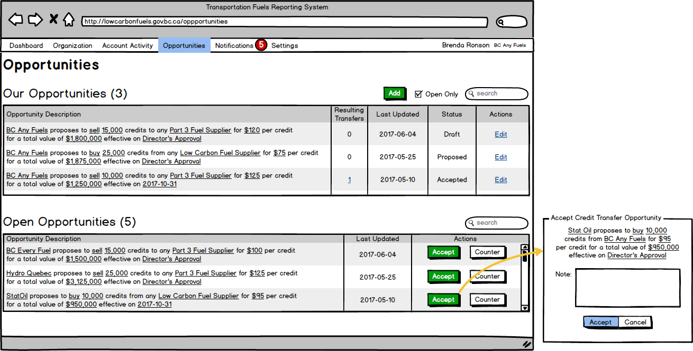
Opportunities – Posted

Slide 8
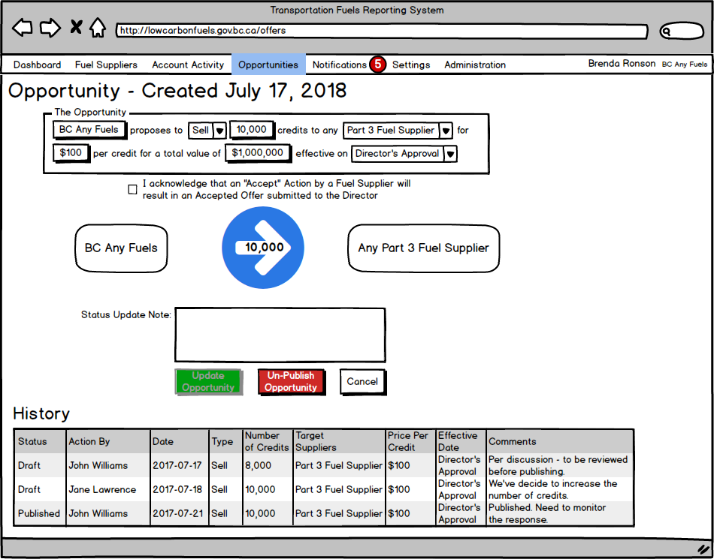
Opportunities – Create/Edit

Slide 9
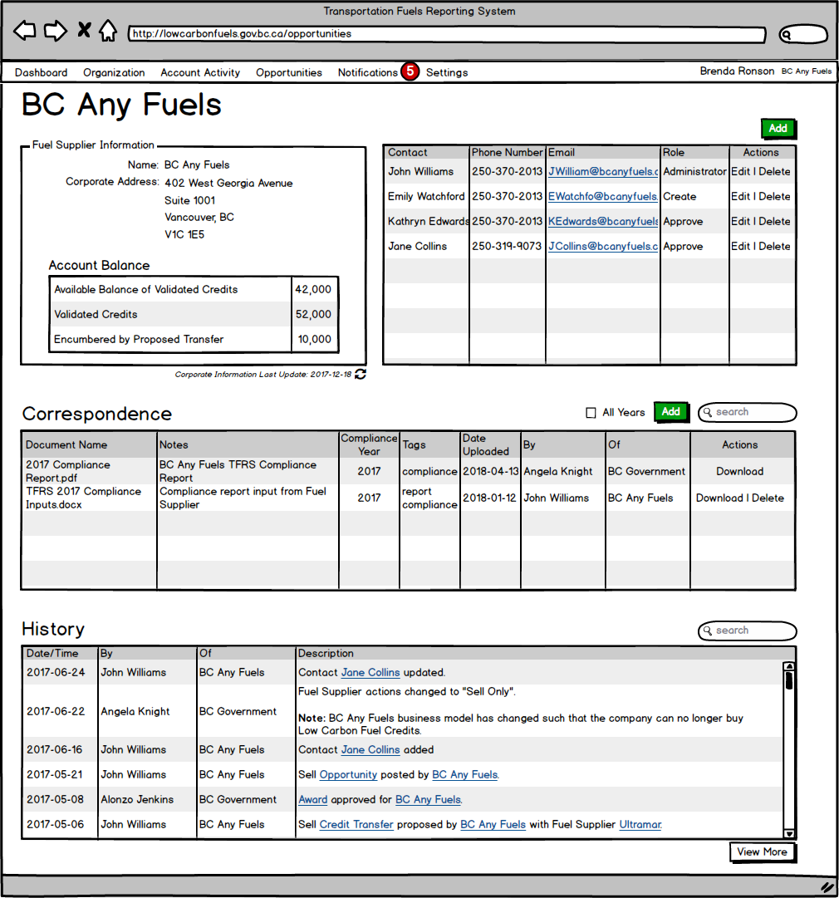
Organizational Information

Slide 10
Follow Up
What do you think – feedback welcome!
Survey –
Anything else you want to tell us about this project?

